Slide 1

Needle Toolkit
PDF Malware Analysis and Risk Assessment Framework
Modular static analysis for triage and reporting
Om Fulsundar — v1.0

Slide 2
Agenda
01
02
03
Project Overview
Architecture & Workflow
Implementation
Understanding the toolkit's purpose and scope
How components work together
Technical highlights and modules
04
05
06
Demo & Outputs
Requirements
Future Work
Sample results and reporting
Dependencies and setup
Enhancements and roadmap
07
Conclusion
Key takeaways and Q&A

Slide 3
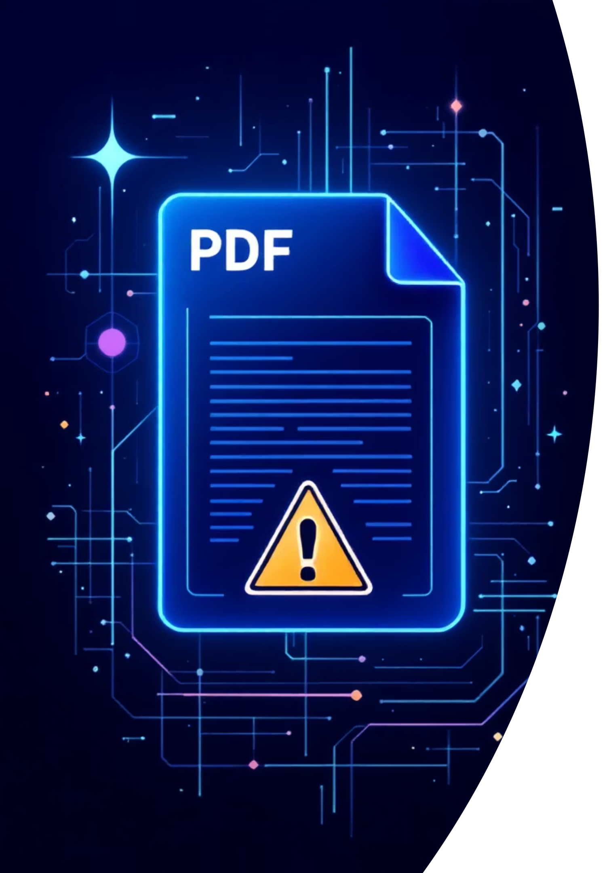
Problem Statement
Why PDF Malware Analysis Matters
PDF documents have become one of the most common vectors for malware delivery. Attackers exploit PDF's flexibility to embed malicious JavaScript, executable content, and obfuscated payloads. Traditional sandboxing is resource-intensive and time-consuming.
Weaponized PDFs
Static Triage Need
Frequently used in phishing campaigns and targeted attacks
Quick analysis required before expensive sandboxing
Reproducible Tools
Analysts need fast, consistent, automated solutions

Slide 4









Project Objectives
Core Goals
This toolkit aims to provide security analysts with a lightweight, modular framework for PDF triage that balances speed with actionable intelligence.
Metadata Inspection
Automate comprehensive metadata and object analysis
IOC Extraction
Identify indicators of compromise and suspicious JavaScript
Risk Scoring
Compute heuristic-based risk scores for prioritisation
Reproducible Reports
Generate consistent, shareable analysis reports

Slide 5
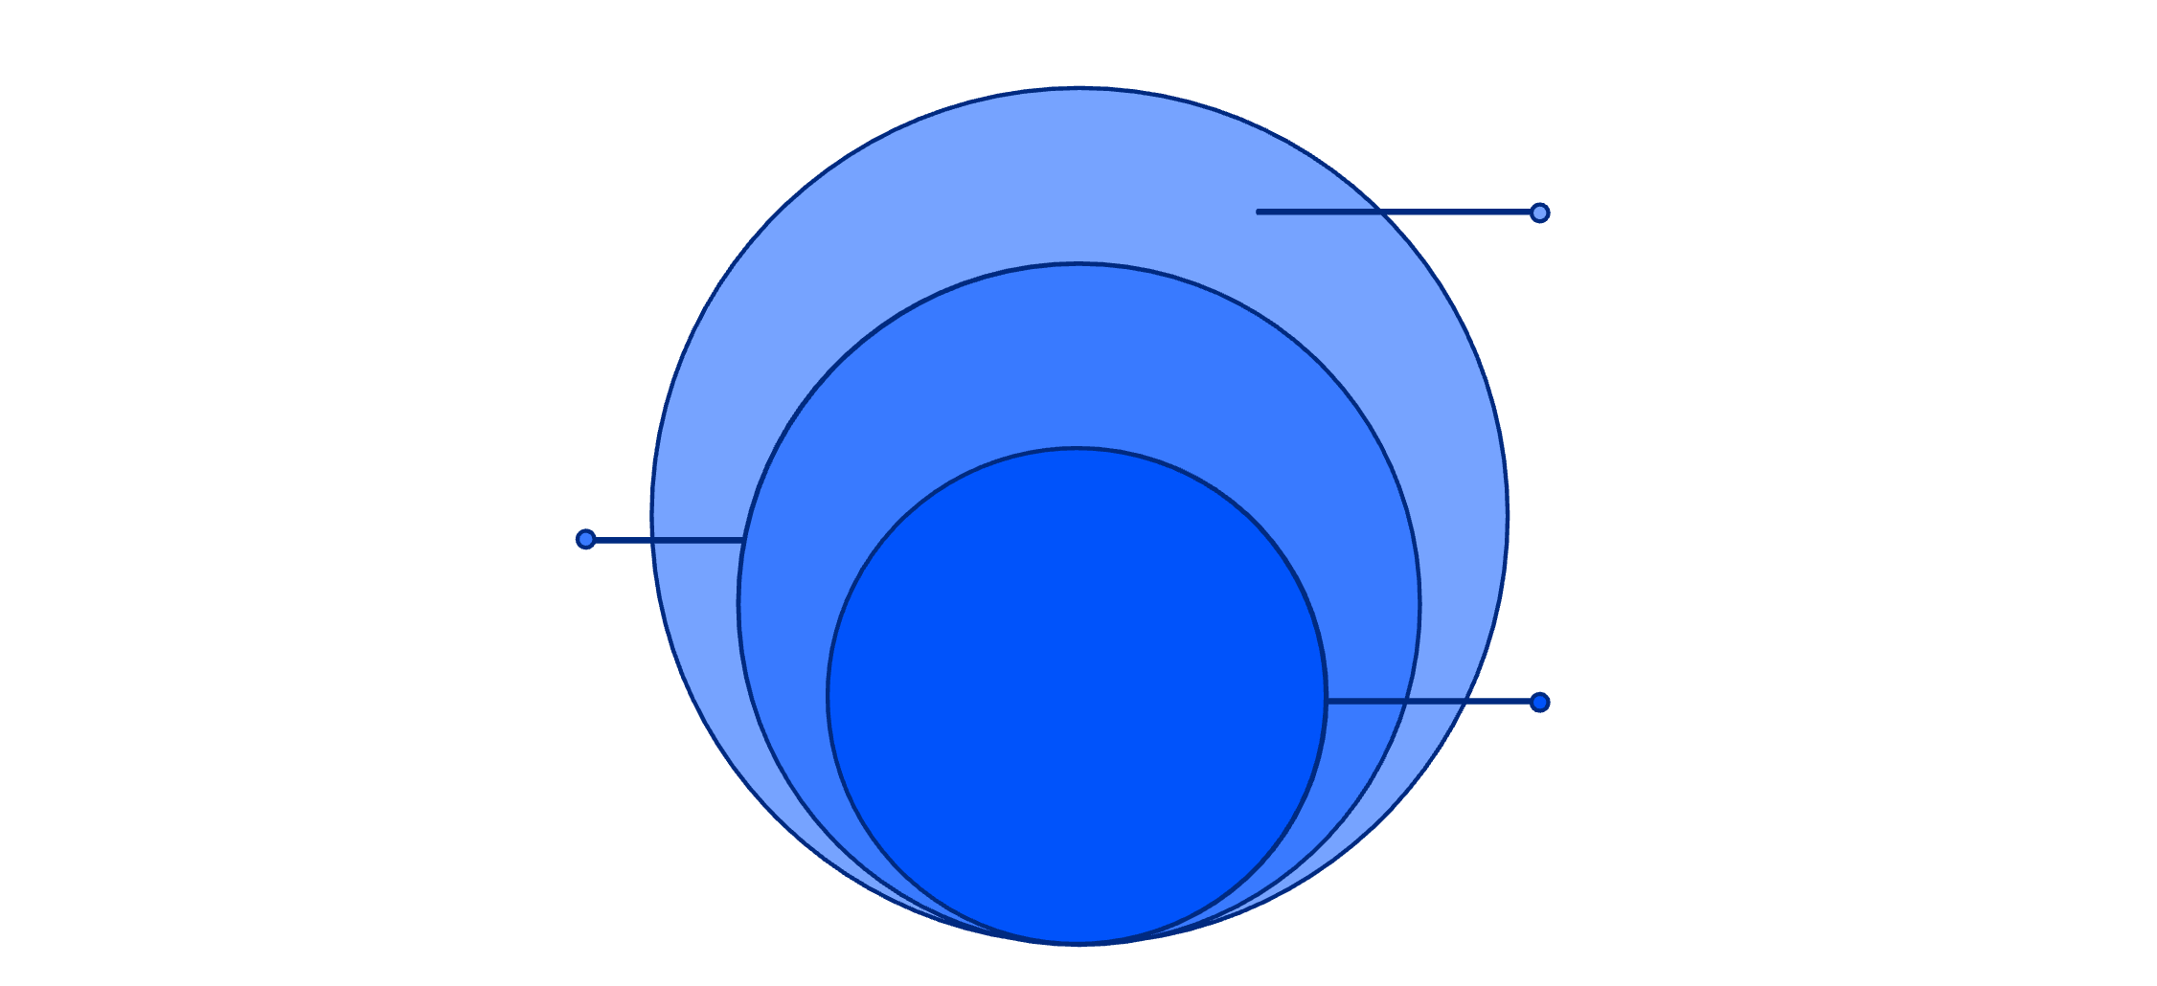
High-Level Architecture
The toolkit follows a layered modular design, processing PDF files through discrete analysis stages before generating risk assessments and reports.
Evaluation & Output
Risk engine evaluation and report generator
Analysis Layer
Metadata, objects, keywords, deep parser, IOCs
Input Layer
PDF file ingestion
Input Layer
Analysis Layer
PDF file ingestion
Multi-module inspection
Evaluation Layer
Output Layer
Risk scoring engine
Report generation

Slide 6
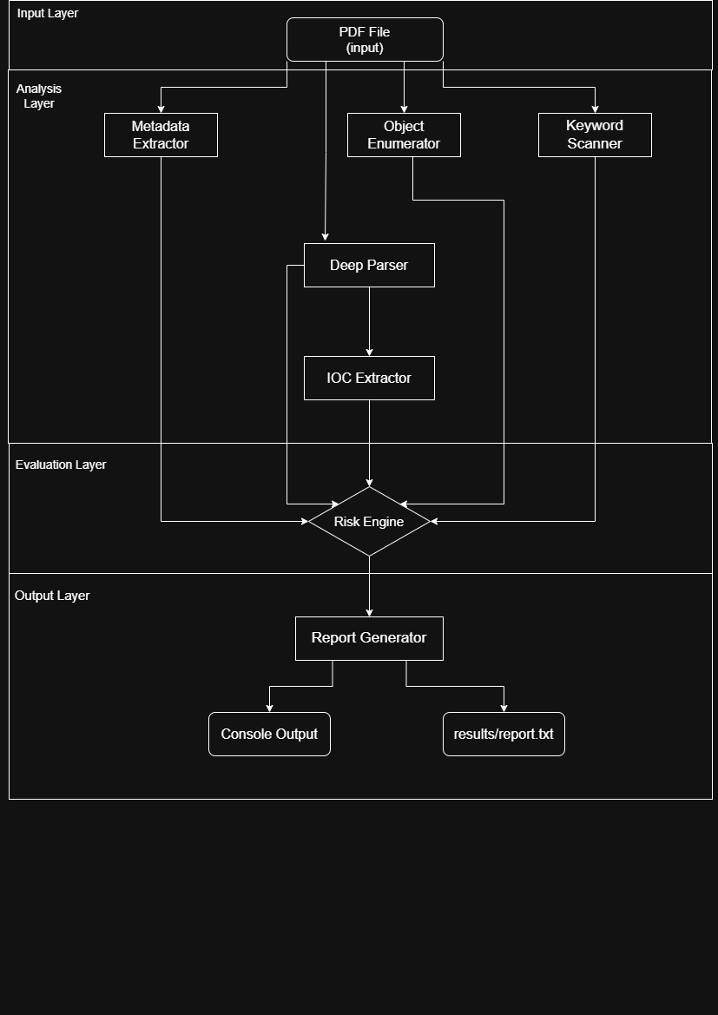

Execution Workflow
Load
Read PDF file and validate format
Extract
Parse metadata and document structure
Scan
Search for suspicious keywords and patterns
Parse
Analyze object structure and content streams
IOC Extract
Identify indicators of compromise
Score
Calculate risk level based on findings
Report
Generate comprehensive analysis report

Slide 7







Implementation Highlights
Technical Stack
Written in Python 3.x with a command-line interface, the toolkit organises functionality into discrete modules that can be run independently or as part of the complete analysis pipeline.
metadata_extractor
object_enumerator
keyword_scanner
Document properties and file characteristics
PDF object structure analysis
Suspicious content detection
deep_parser
ioc_extractor
risk_engine
Content stream analysis
Indicator identification
Heuristic scoring
report
Results formatting
Output: Results saved to results/ directory with timestamped reports

Slide 8
Requirements & Dependencies
Core Libraries
Minimal dependencies ensure the toolkit remains lightweight and easy to deploy across different environments.
Python 3.x
PyPDF2
re
Main runtime environment
PDF parsing and manipulation
Regular expression matching
hashlib
datetime
Cryptographic hashing
Timestamp generation
Optional Tools
Enhanced analysis capabilities through integration with external utilities:
qpdf: PDF normalisation and structure analysis
pdfid: Quick identifier scanning
pdf-parser.py: Advanced content inspection

Slide 9
Risk Scoring Methodology
Heuristic-Based Risk Calculation
The risk engine employs weighted indicators to compute an overall threat score.
Each suspicious finding contributes points based on configurable weights, allowing analysts to tune sensitivity for their environment.
Metadata Anomalies
JavaScript Detection
Embedded Files
Unusual properties, timestamps, or author information
Embedded scripts and action triggers
External content attachments and streams
IOC Matches
Obfuscation Techniques
Known malicious indicators and patterns
Encoding, compression, and hiding methods

Slide 10

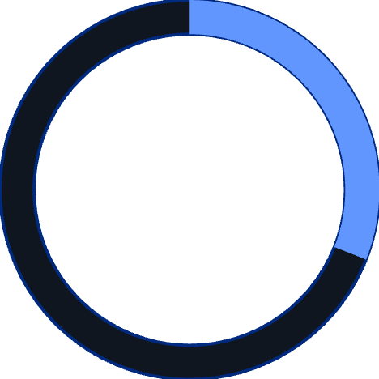
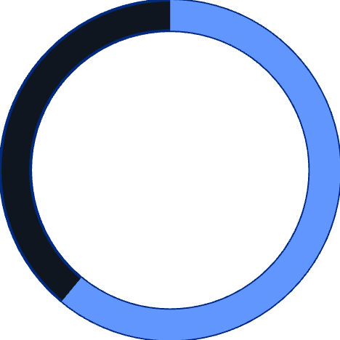
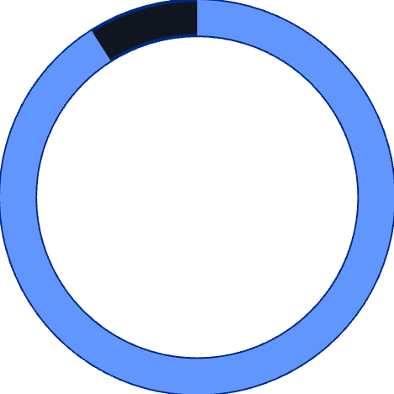
0-30%
31-60%
Low Risk
Medium Risk
Normal PDF characteristics
Some suspicious elements
61-90%
91-100%
High Risk
Critical Risk
Multiple red flags detected
High-confidence malware indicators

Slide 11

Outputs, Limitations & Next Steps
Sample Outputs :
The toolkit generates console summaries and detailed reports saved to the results directory. Output includes metadata, object analysis, keyword matches, IOC findings, and risk scores.
Note: Risk scores are heuristic and intended for triage prioritisation, not final verdicts.
Current Limitations :
Static analysis only
No dynamic JavaScript execution or sandboxing
Batch processing
No encrypted PDF support
Parallel analysis of multiple files
Cannot analyse password-protected files
Regex-based IOC detection
Future Enhancements
May miss sophisticated obfuscation techniques
Threat intelligence integration
Basic JS parsing
Limited understanding of complex JavaScript logic
Real-time TI feed and AV/YARA rule matching
Dynamic sandboxing option
HTML/PDF export
Optional automated sandbox analysis
Rich report formats with dashboards
Enhanced JS AST parsing
Abstract syntax tree analysis for complex scripts

Slide 12
Conclusion
Needle provides fast, modular static triage for PDF malware analysis, suitable for interns, SOC analysts, and researchers.
The toolkit encourages layered defences and reproducible reporting, with clear pathways for extension and enhancement.
Thank You !

